Slide 1
CS440 Foundation of Cybersecurity
Week3: Public Key Encryption

Slide 2








Review of Week 2
Fundamentals of encryption: to remove patterns from data.
One-time pad achieves perfect security, but is impractical.
Modern ciphers have fixed key sizes and allow repeated use.
In symmetric key cipher, the same key is used for encryption and decryption.
AES is the current standard of block cipher encryption
  key size: 128 bits, 192 bits, and 256 bits
  block size: 128 bits.
A block cipher is the algorithm that takes a key as the parameter and computes the mapping between one message block and one ciphertext block.
Block ciphers can operate in ECB, CBC and CTR modes for message encryption.
  ECB is not secure. It preserves the patterns among message blocks. No randomness
  CBC is secure. It uses IV to inject randomness and use a “chain” to remove patterns at the block level.
  CTR is secure. It uses IV as the initial value of a mono-increasing counter and generates a pseudo-random key stream by encrypting the counter values.

Slide 3




Exercise: bruteforce attack
Intercept ciphertext and infer k
Mallory
Nz dsfejr dbse ovncds jt…
text
Bob
ciphertext
Alice
Mallory tricks Alice into sending a message P and intercepts the resulting cipher C
Given C = E(k, P), he knows P, C, E
He then bruteforces C with various keys and compares with P, offline!
If he gets back the original message P from C, he then finds the AES key k
But in practice, brute-forcing a standard AES key is computationally infeasible, with our current computing power. See the next slide…

Slide 4
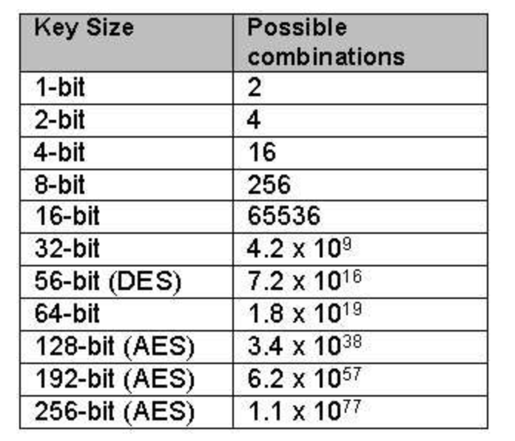






Exercise: bruteforce attack
Using one of the fastest supercomputers in 2019
No. of combination checks per second = 10¹⁴ (100 million million)
No. of seconds in one Year = 365 x 24 x 60 x 60 = 31536000
No. of Years to crack AES with 256-bit Key
= 1.1 * 10⁷⁷ / ( 10¹⁴ x 31536000 )
~ 3.5 * 10⁵⁵ years
~ billions of years

Slide 5
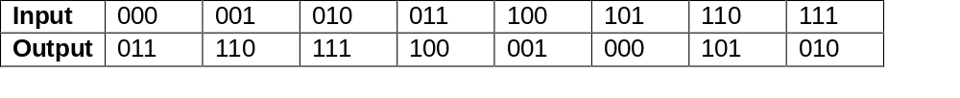

Exercise: operation mode
Consider the following simple block cipher with block size 3 where a 3-bit input is substituted by a 3-bit output (e.g., the encryption of message block 000 gives the ciphertext block 011, the encryption of 001 gives 110, etc.).
Given a plaintext 101 000, compute the corresponding ciphertext when the following operations modes are applied with IV = 010. (Hint: 0 ⊕1 = 1, 1⊕1= 0⊕0 = 0)
ECB
CBC
ECB: 000 011 CBC: 010 010 111
101 ⊕ 010 --> 111 --enc--> 010
010 ⊕ 000 --> 010 --enc--> 111

Slide 6
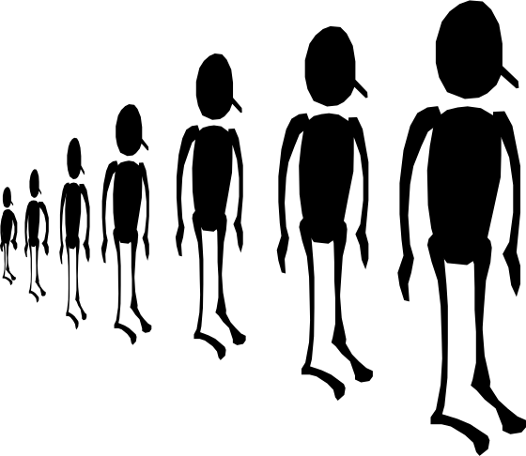




Troubles of Secret Key Distribution
how do I send the key to my recipient securely?
Symmetric key encryption:
Requires a SECURE key distribution channel
Not scalable.
Oooops, I have to keep so many secret keys for them!
Pair-wise secure communication among n users:
n(n-1)/2 different secret keys in total
n-1 secret key stored by each user

Slide 7











Another approach…

Slide 8


Asymmetric Cryptosystem
Alice Bob
Bob’s public key is accessible to everyone whereas the private key is only known to Bob.
Requirement: It should be computationally infeasible to compute the private key from the public key.
Plaintex
Encryption Algorithm Enc
Ciphertext
Decryption Algorithm Dec
Plaintext
M
C
M
Bob’s public key
Bob’s private key

Slide 9






Asymmetric Key Encryption
Alice
Bob
Hello, Bob
Hello, Bob
public key
private key
Symmetric Key Encryption
Hello, Bob
Hello, Bob
shared key
shared key

Slide 10
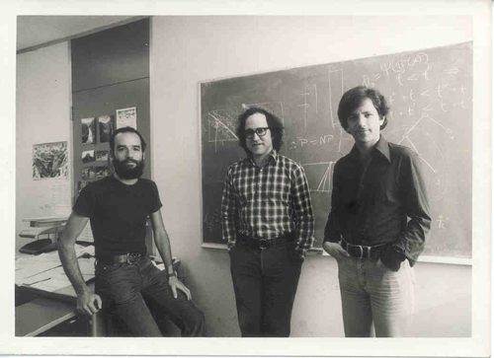
Rivest-Shamir-Adleman

Slide 11
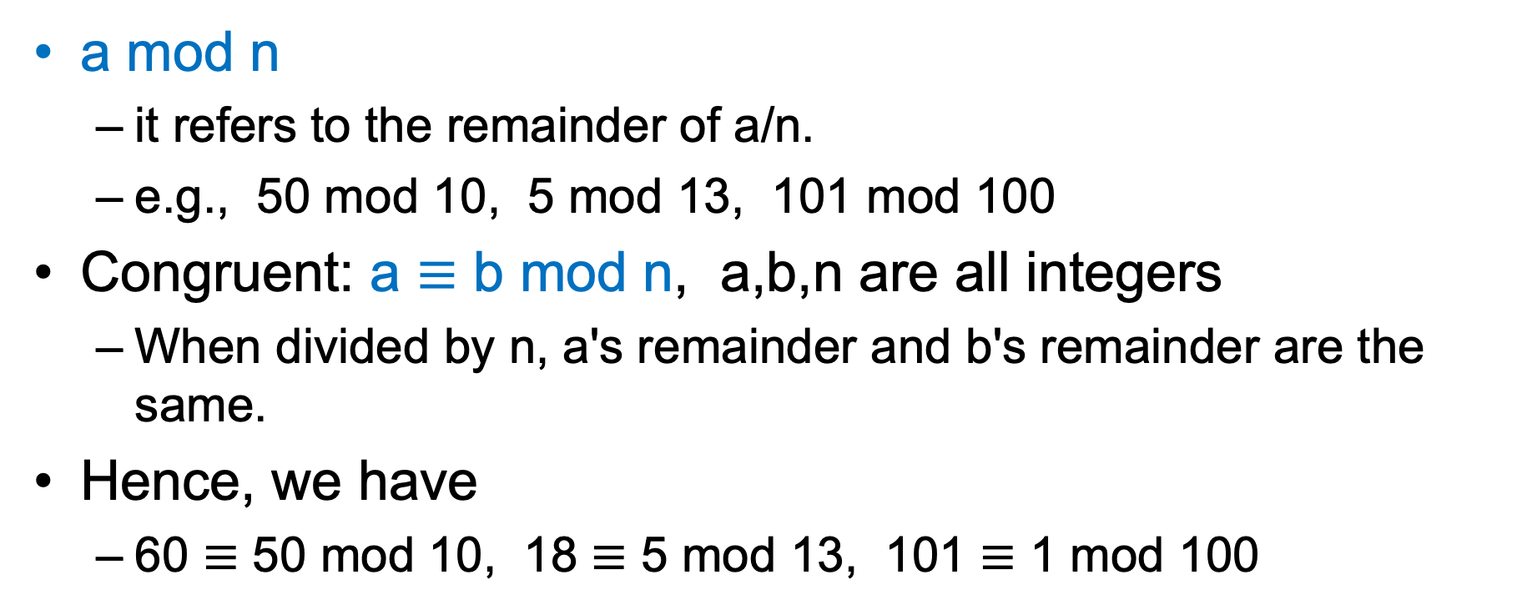

Notations (FYI, non-examinable)
a mod n
  it refers to the remainder of a/n.
  e.g., 50 mod 10, 5 mod 13, 101 mod 100
Congruent: a $≡$ b mod n, a,b,n are all integers
  When divided by n, a's remainder and b's remainder are the same.
Hence, we have
  60 $≡$ 50 mod 10, 18 $≡$ 5 mod 13, 101 $≡$ 1 mod 100

Slide 12





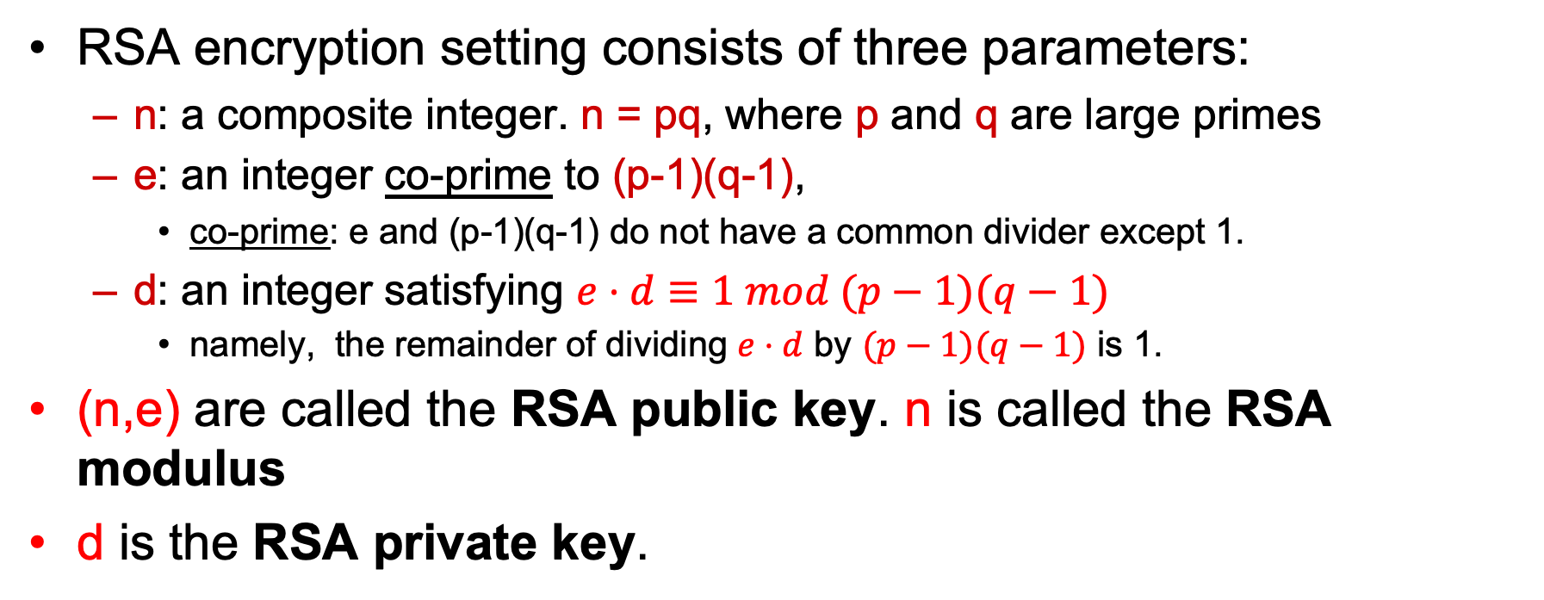

RSA Setting
RSA encryption setting consists of three parameters:
  n: a composite integer. n = pq, where p and q are large primes
  e: an integer co-prime to (p-1)(q-1),
    co-prime: e and (p-1)(q-1) do not have a common divider except 1.
  d: an integer satisfying $e⋅d≡1 mod (p−1)(q−1)$
    namely, the remainder of dividing $e⋅d$ by $(p−1)(q−1)$ is 1.
(n,e) are called the RSA public key. n is called the RSA modulus
d is the RSA private key.
FYI Only
FYI: for any number x, if x is coprime to n, $x^{(p−1)(q−1)}≡1 mod n$

Slide 13







How to use RSA
RSA encryption is performed only on integers smaller than the RSA modulus!!!
Given a message, which is converted into a number 0 ≤ M<n
Suppose Alice’s RSA public key (n,e), private key d.
Encryption formula (by Bob): to encrypt M, compute Me mod n as C
Decryption formula (by Alice): to decrypt C, compute C^{d} mod n as M
C
M
Bob
Alice
C ⬅Me mod n
M ⬅C^{d} mod n
d: Alice’s private key
n,e: Alice’s public key
Notes:
a = b mod n → a is congruent to b modulo n; the modulus is n; the residue is a.

Slide 14
A Toy Example (non-examinable)
Choose p=11 and q=13
n=11*13=143
(p-1)(q-1)=10*12=120
Choose e=37 //GCD(37,120)=1
Using the extended GCD/Euclidian algorithm (out of scope) we find d such that e*d=1 mod 120
d=13 //e*d=481=1 mod 120

Slide 15
A Toy Example (non-examinable)
To encrypt a message X = 3
Y = Xe mod n = 3³⁷ mod 143 = 42
To decrypt a ciphertext Y = 42
X = Y^{d} mod n = 42¹³ mod 143 = 3

Slide 16














Textbook RSA is Deterministic
Encryption of P: C=P^{e} mod n Decryption of C: P=C^{d} mod n
The above encryption is deterministic
  Suppose that you know C is an encryption of a four-digit pin, can you crack C to find the pin without knowing d?
Public key encryption must resist chosen plaintext attacks, why?
    Because the attacker can perform encryption for any message using the known public key!
Notes:
Everyone can do the encryption, so it can be used to analyse the text and the pattern, depending on what they choose.

Slide 17
Randomized RSA via Padding (non-examinable)
m || 0…0
r
G
randomness
H
e
c =
m₁
m₂
mod n
Optimal Asymmetric Encryption Padding (RSA-OAEP)

Slide 18




Computational Security of RSA
The security depends on whether the attacker can factor n.
What if we choose a modulus n whose hexadecimal representation is
06 75 cf c4 3c 71 cd 40 2c 9e 91 7b 94 a0 a3 95 e5 75 6c 3e a3 96 a6 f7 08 10 63 76 0f 3d 46 6c fa 1a a2 8c f9 81 bb f1 4b 88 26 8d af fe 1a 58 00 ba e3 7c c5 76 98 29 41 3f 2a b5 6b 6f c2 a9 d0 ea 9e ad 70 32 50 fa c0 ba 2b 85 5a f2 10 85 8c 51 91 ec e0 12 41 71 f8 32 2d 22 5e ec 2f d1 cd 3e aa d0 aa af 7e 4a f8 b2 4a 6a ae ee 92 f4 3c a5 a3 7b 2b 4f a9 ea f9 02 03 01 00 01
It is commonly agreed that when n is large enough and n is in the form of p*q, it is infeasible to factor n in practice.
FYI: integer factorization can be solved by quantum computers!
Notes:
analogy of high speed camera and coin toss

Slide 19
RSA Key Size and Security
It is common to choose n to be 2048 bits (or 2K bits)
  Security depends on difficulty of solving factorization problem to get p and q from n.
Recommended key length
  https://www.keylength.com/en/4/

Slide 20
Comparison
Asymmetric encryption | Symmetric Encryption
Public keys can be sent over a public channel | A secret key must be distributed over a secure channel
Scalable for multi-party communication | Non-scalable for multi-party communication
Long keys | Relative short keys (e.g., 128 bits)
Slow encryption speed | Fast encryption speed

Slide 21

Limitation of RSA encryption
trouble in encrypting large files!
  when being converted to an integer, it may be bigger than the RSA modulus in use and cannot be encrypted directly.

Slide 22






Another approach…

Slide 23
Another approach…

Slide 24
A hybrid approach: envelope encryption
A hybrid of public key encryption and symmetric key encryption.
Alice’s Encryption for her message m to Bob:
  Select a random symmetric key k, e.g. an AES key.
  Use k to encrypt m to get the ciphertext C1.
  Use Bob’s RSA public key to encrypt k, to get the ciphertex C2.
  Send (C1,C2) to Bob.
Bob’s Decryption:
  Use his RSA private key to decipher C2 to get k.
  Use k to decipher C1 to get m

Slide 25





Non-interactive RSA-based Secret Key Distribution
Hybrid encryption is in essence a message encryption combined with an RSA-based secret key distribution.
k
(d)
(n,e)
c=k^{e} mod n
k=c^{d} mod n

Slide 26
Significance of RSA
Solve the challenging problem of secure key distribution in the symmetric key setting.
Practically speaking, the RSA cipher is rarely used for data encryption.
It is mainly used to establish a secure channel without using any shared secret.
  this channel can then be used to distribute secrets/keys.
There are many other public key encryption algorithms. But RSA is the most commonly used and studied one, due to it simplicity.

Slide 27
Takeaways
Importance of public key encryption
Details of RSA encryption (what it is and how it works)
Comparison between public key encryption and symmetric key encryption
Hybrid encryption (a.k.a. envelope encryption)

